Slide 1
IQ, trading behavior, and performance
Mark Grinblatt , Matti Keloharju , Juhani T. Linnainmaa
BCG lab seminar Feb 19th, 2021

Slide 2
Overview
This paper shows that IQ influences on trading behavior, performance, and transaction costs
High IQ investors are less subject to the disposition effect, more aggressive about tax-loss trading.
They also exhibit superior market timing, stock-picking skill, and trade execution.
1
2
3

Slide 3
Data
HEX (Helsinki Exchanges) data – daily transaction prices data from Jan, 1994 to Nov, 2002
FCSD (Finnish Central Securities Depository) – Daily portfolios data
FAF (Finnish Armed Forces) – Intelligence score data
1
2
3

Slide 4
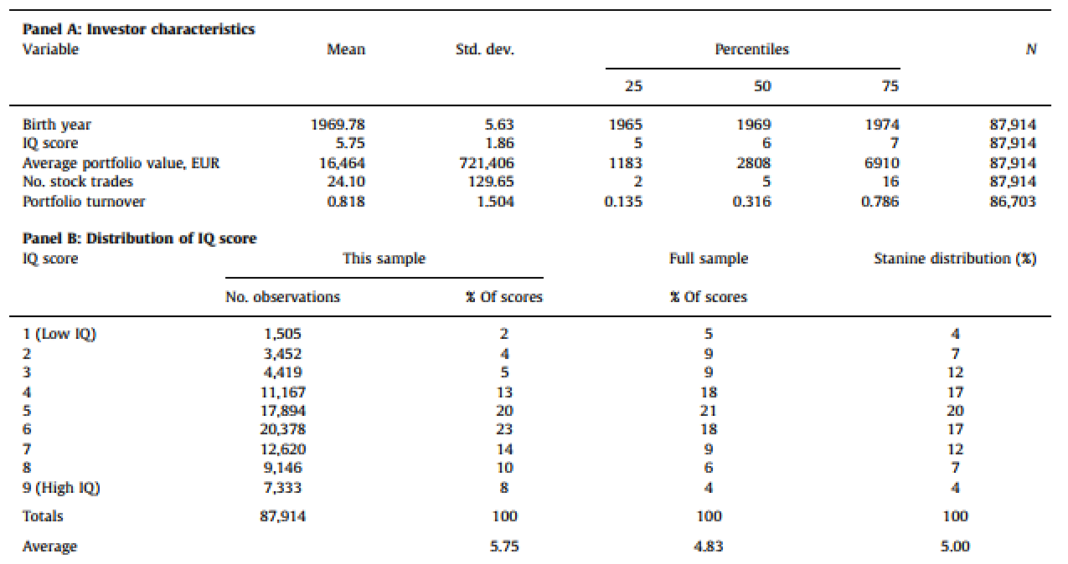
Summary statistics

Slide 5
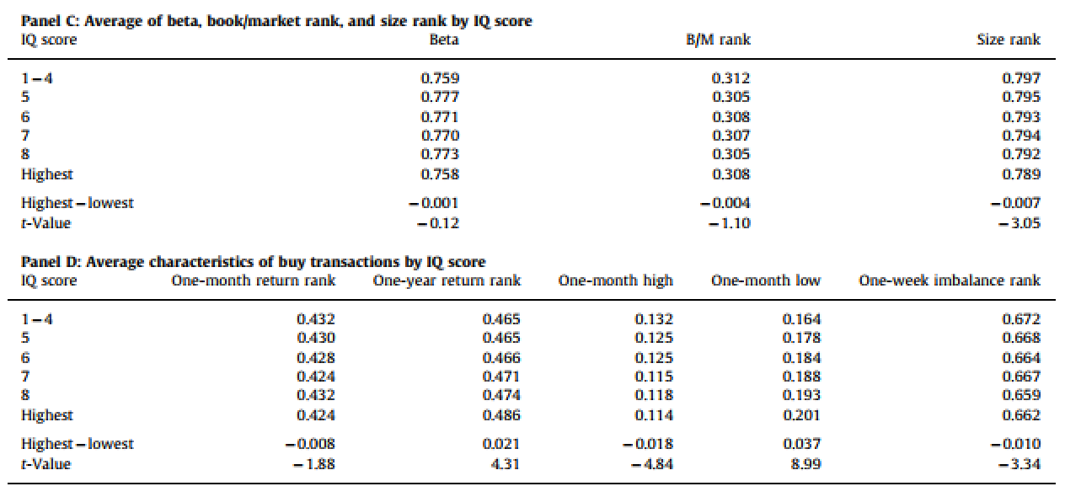
Summary statistics

Slide 6
Terms
The disposition effect
Tax-loss selling
Reference price effect
Herding
1
2
3
4

Slide 7
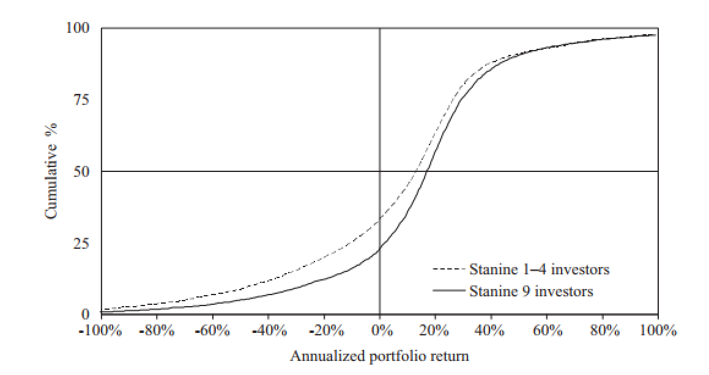
Fig 1. Intelligence and portfolio return

Slide 8
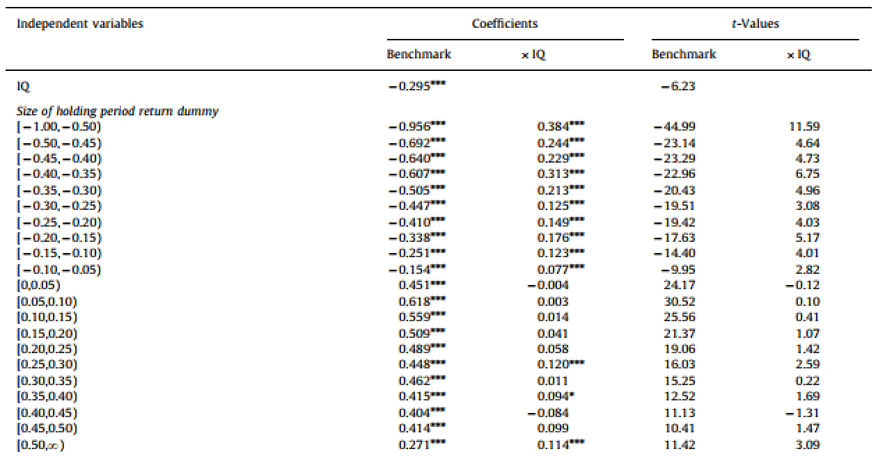
Results 1. Intelligence and sell vs hold decision

Slide 9
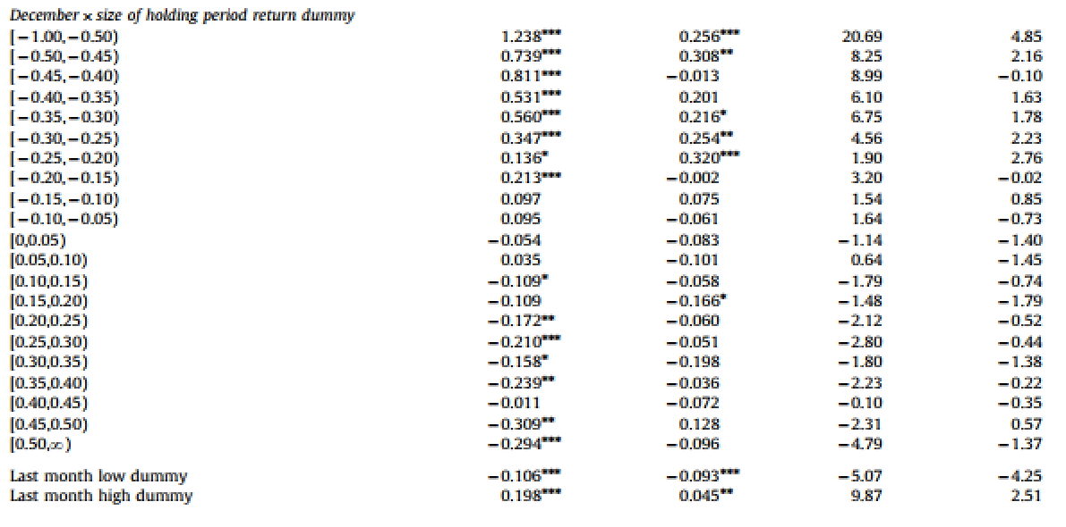
Results 1. Intelligence and sell vs hold decision

Slide 10
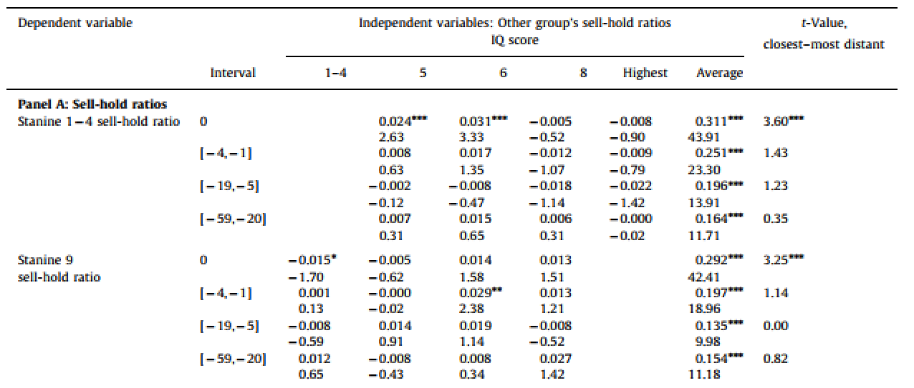
Results 2. Interactions in trading behavior between IQ groups

Slide 11
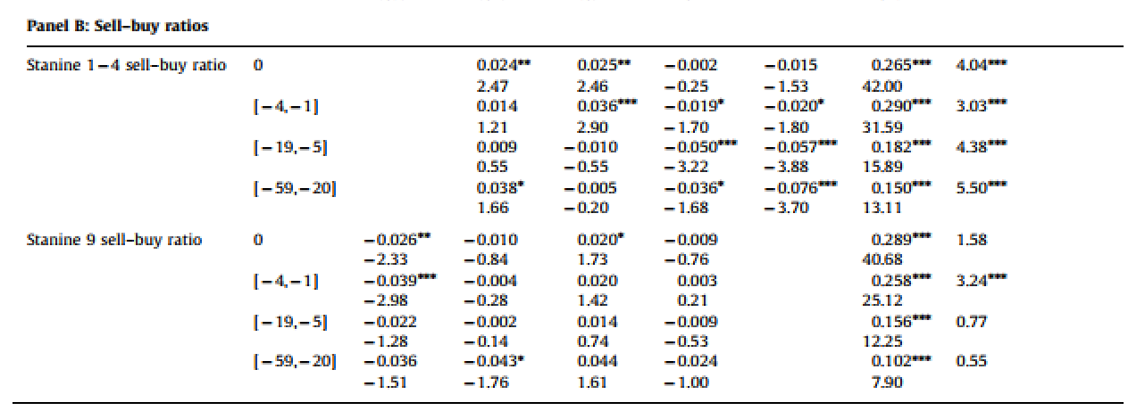
Results 2. Interactions in trading behavior between IQ groups

Slide 12
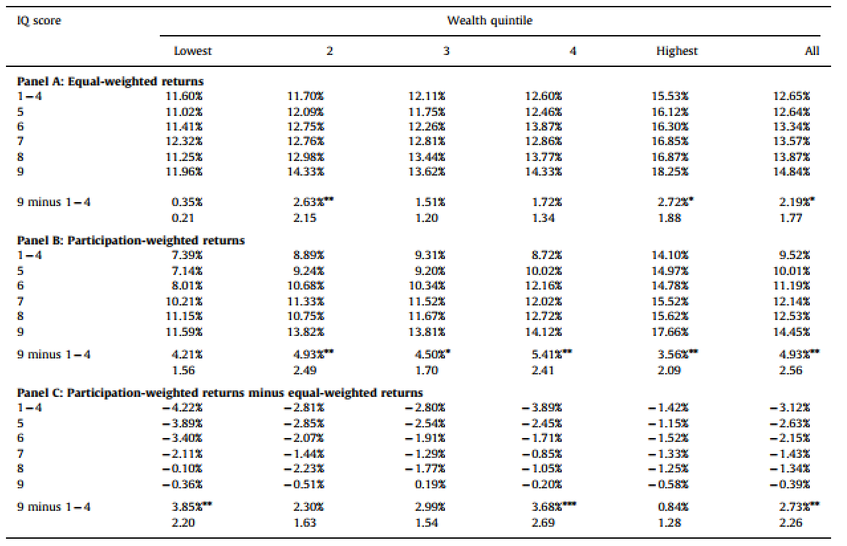
Results 3. Interactions in trading behavior in IQ group

Slide 13
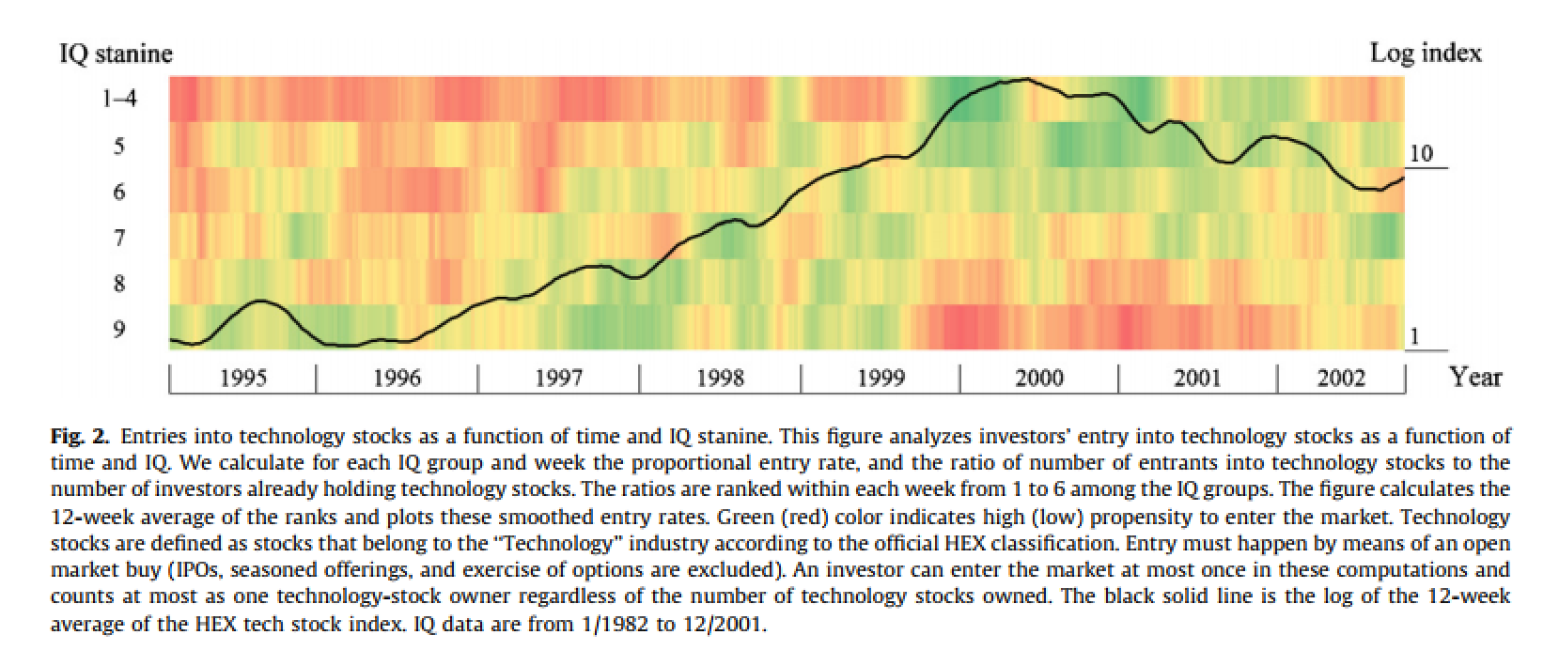
Fig 2. Intelligence and performance of trades

Slide 14
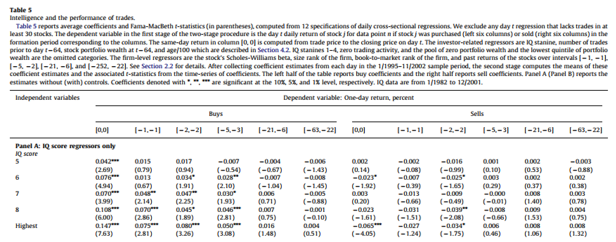
Results 4. Intelligence and performance of trades

Slide 15
Results 4. Intelligence and performance of trades

Slide 16
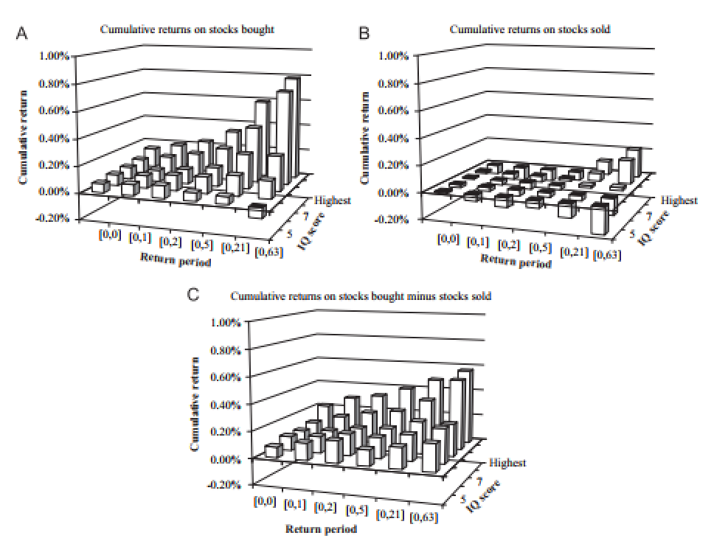
Fig 3. Intelligence and cumulative returns

Slide 17
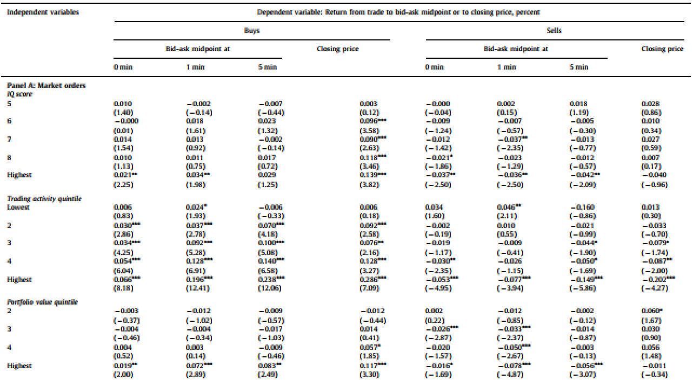
Results 5. Intelligence and transaction cost

Slide 18
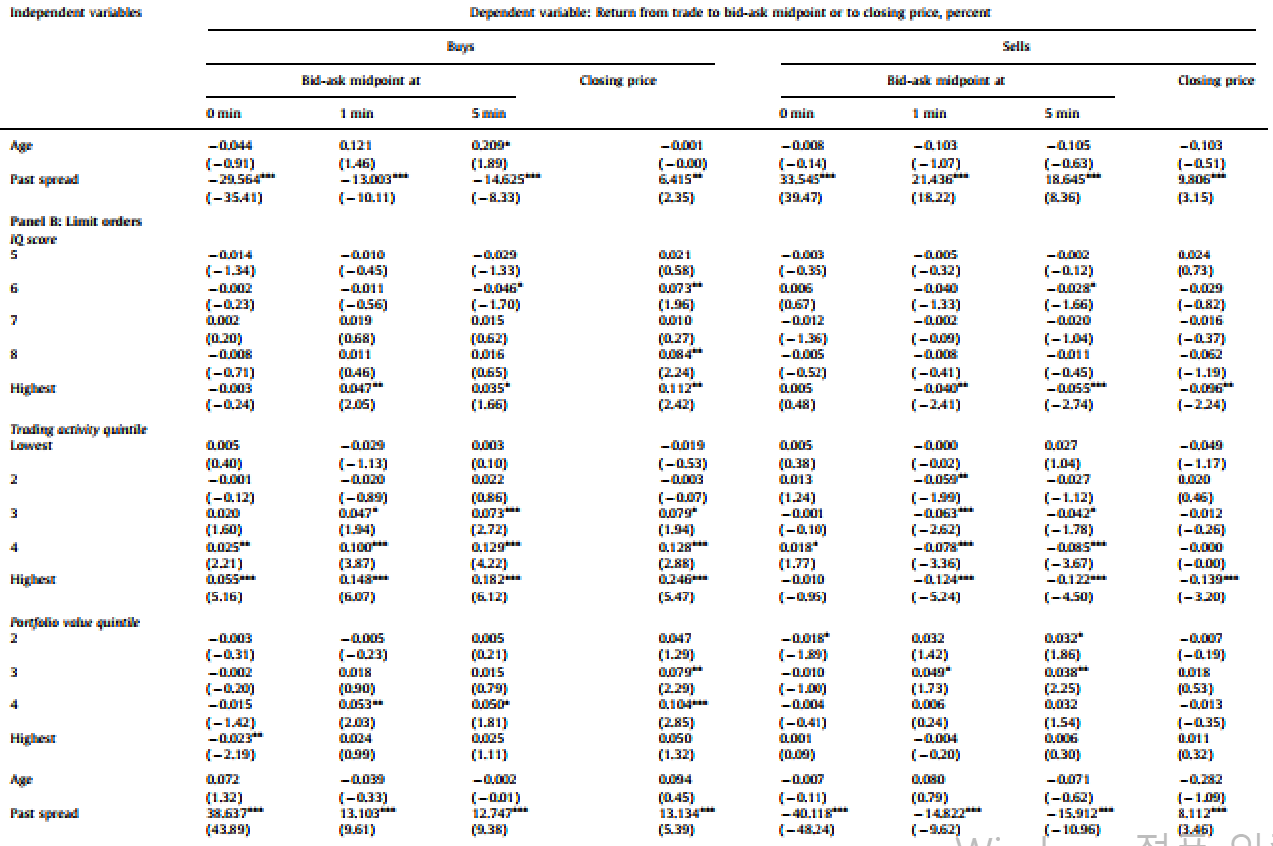
Results 5. Intelligence and transaction cost

Slide 19
Conclusion
This paper shows that IQ influences on trading behavior, performance, and transaction costs
High IQ investors are less subject to the disposition effect, more aggressive about tax-loss trading.
They also exhibit superior market timing, stock-picking skill, and trade execution.
1
2
3

Slide 20
Discussion
Selection bias
External validity
Herding

Slide 21
Any Question or Comment?
Thanks for listening
Notes:
슬라이드 쇼 모드에서 화살표를 선택하여 링크를 방문하세요.

